Slide 1
1
Typed languages
7
Polymorphism
OOP
2
Object/Class
6
Inheritance
3
Aggregation
5
Objects references
4
Encapsulation

Slide 2
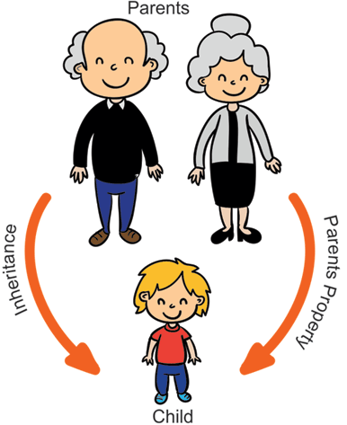
Inheritance
Some properties of mom are inherited by her daughter

Slide 3






In a hospital, we have the following people:
TRY TO
CODE IT
A person has a name, an address a date of birth
PERSON
An employee is a person
But has salary and year of arrival in the hospital
A patient is a person
But has a health history
EMPLOYEE
PATIENT
A doctor is an employee
But has a medical speciality
A manager is an employee
But has skills in management
DOCTOR
MANAGER

Slide 4
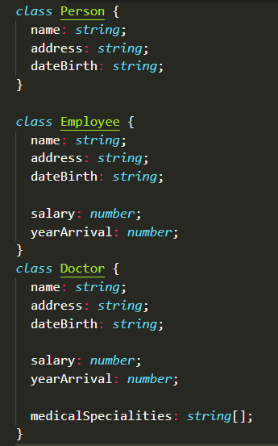
SOLUTION
ONE
What do you think about
this first solution ?

Slide 5

A class can inherit from another class
Person
- name : string
UML class diagram
Student
Inherits from
Person
Student
- batch: string

Slide 6
A class can inherit from another class
Animal
Carnivore gets the
Attributes
Methods
from animal
Carnivore
Herbivore
+ eatMeat()
+ eatGrass()
Human gets the
Attributes
Methods
from Carnivore
Human
Rabbit
+ talk()
- color : string

Slide 7
Child class gets attributes from super class
DEMO - 1
Person
class Person {
name = "aa";
address = "bb";
}
class Employee extends Person {
salary = 1000;
}
let ronan = new Employee();
console.log(ronan);
SUPER
CLASS
+ name:string
+ address:string
EXTENDS IS THE KEYWORD TO INHERIT !
Employee
CHILD
CLASS
+ salary:number
WHAT WILL IT PRINT ?

Slide 8
Child constructor must call the super constructor
DEMO - 2
class Person {
name: string;
address: string;
constructor(name: string, address: string) {
this.name = name;
this.address = address;
}
}
class Employee extends Person {
salary: number;
constructor(name: string, address: string, salary: number) {
super(name, address);
this.salary = salary; }
}
let ronan = new Employee("ronan", "paris", 400);
console.log(ronan);
super()
is a call to the
Super’s
Constructor !!

Slide 9

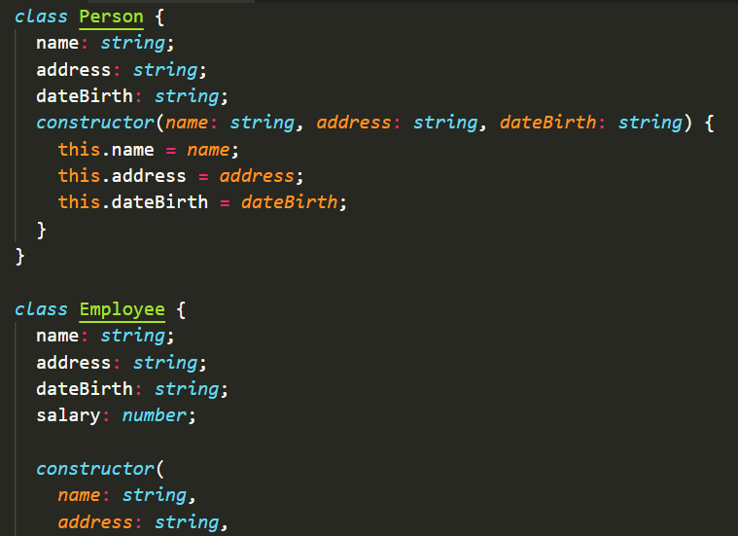
ACTIVITY 1
15 MIN
1 - Change Hospital.ts
to avoid duplication of attributes
To do this:
Employee must extend Person
Doctor must extend Employee
2 - Add the Manager :
A manager is an employee
But has skills in management
MANAGER
3 - Test your code !! (create some objects)

Slide 10


You cannot extend everything !
A doctor is not a hospital
A doctor is an employee
Hospital
Employee
Doctor
Doctor

Slide 11
super can also be used to access a parent method
class Person {
name = "aa";
printMe() {
console.log("name : " + this.name);
}
}
class Employee extends Person {
salary = 1000;
printMe() {
super.printMe();
console.log(“salary : " + this.salary);
}
}
let ronan = new Employee();
ronan.printMe();
Person
+ name:string
+ printMe()
Employee
+ salary:number
+ printMe()
WHAT WILL IT PRINT ?

Slide 12
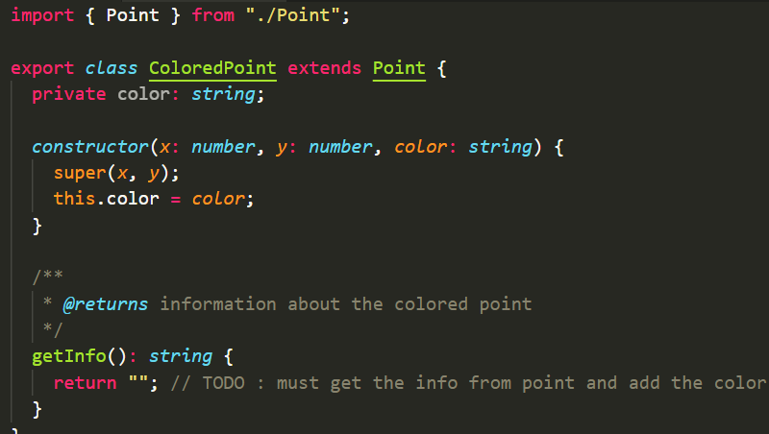
ACTIVITY 2
15 MIN
Update the code of ColoredPoint:
getInfo() must return the existing info related to Point + color
Example :
let p2 = new ColoredPoint(10, 20, "red");
Let info = p2.getInfo()
Shall return:
position x=10 y=20 and color=red

Slide 13


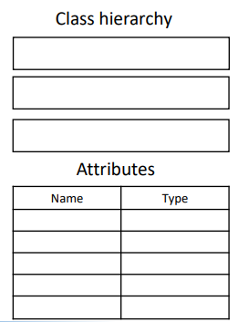
ACTIVITY
15 MIN
super
constructor
super
constructor
constructor
object
MAGIC DOG
object
DOG
object
ANIMAL

Slide 14
Visibility : PRIVATE
PRIVATE attributes are visible only inside the CLASS
Person
Anywhere in code
- name : string
Person

Slide 15
Visibility : PRIVATE > PROTECTED
PROTECTED attributes are visible inside CLASS but also child CLASSES
Person
Anywhere in code
- name : string
Student
# address : string
Person
Student

Slide 16
Visibility : PRIVATE > PROTECTED > PUBLIC
PUBLIC attributes can be used from anywhere
Person
Anywhere in code
- name : string
Student
# address : string
Person
+ batch: string
Student

Slide 17
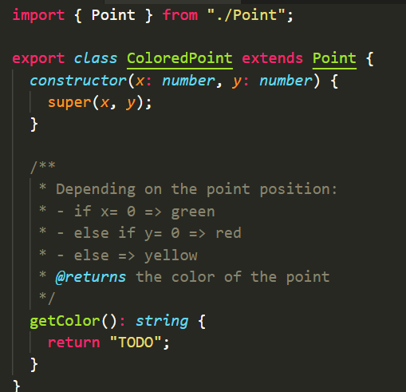
ACTIVITY 3
15 MIN
This time the color is NOT an attribute
But it’s a computed value!!!
Code the method getColor: following the
instructions

Slide 18

Abstract classes

Slide 19


We want to play the sounds of animals…
MEOWW !!
WOOF !!

Slide 20
So we create a class Animal and 2 sub classes :
Animal
# name:string
Cat
Dog
MEOWW !!
WOOF !!
+ playSound()
+ playSound()
new Audio(‘cat.mp3').play()
new Audio(‘dog.mp3').play()

Slide 21
From a list of animals : can we play the sounds?
Animal
# name:string
Let animals : Animal[]= [];
// code to add animals..
for(animal of animals) {
animal.playSound();
}
Cat
Dog
+ playSound()
+ playSound()

Slide 22
Let’s add playSound as an abstract method
Abstract
Animal is an abstract class: it can contain abstract methods
Animal
# name:string
+ playSound()
playSound is an abstract method: the body of the method is not
yet written => the children will do it !
Cat
Dog
Class Dog extends the abstract class Animal
So: it MUST implement
the method playSound()
+ playSound()
+ playSound()

Slide 23
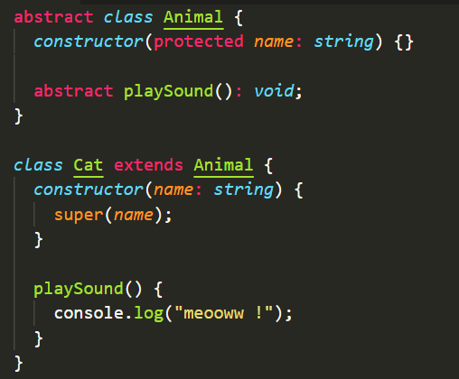
Let’s code it
DEMO - 3
Abstract
Animal
# name:string
+ playSound()
Cat
Dog
+ playSound()
+ playSound()

Slide 24
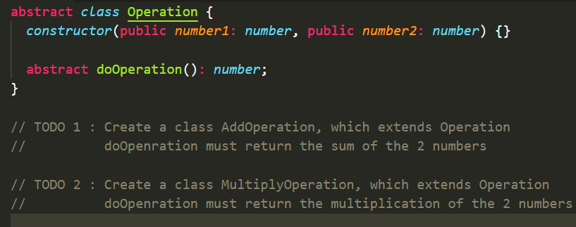
ACTIVITY 4
15 MIN
Operation is an abstract class to perform
an operation between 2 numbers
Code 2 classes :
One to add the 2 numbers
One to multiply the 2 numbers

Slide 25

NOW I KNOW :
How to inherit from class and why
The meaning of Super in constructor
The meaning of Super in methods
The visibility : private > protected > public
What is an abstract class and abstract methods

